Slide 1
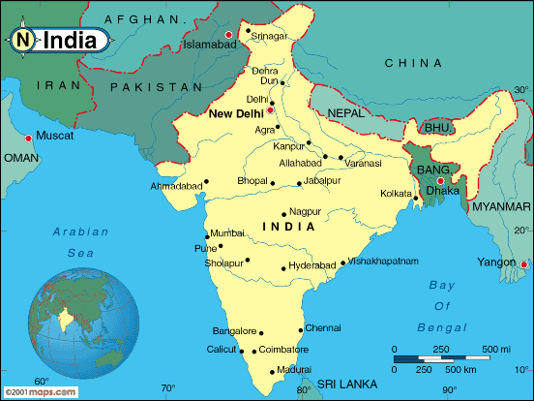
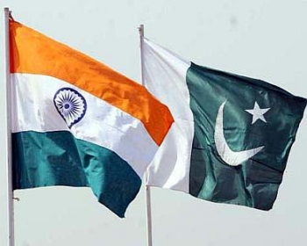
SOUTH ASIA: INDIA & PAKISTAN

Slide 2
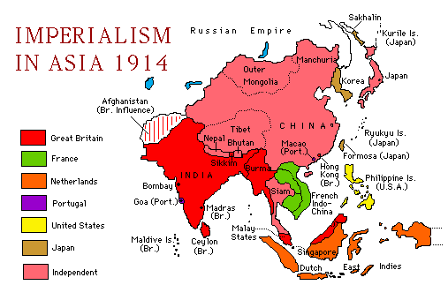
COLONIALISM IN ASIA
Between 1870-1914 European nations engaged in imperialism, bringing much of the world under their control.
Imperialism is the domination by one country of the political, economic & cultural life of another country or region.

Slide 3
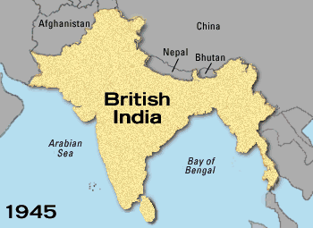
BRITISH COLONIAL RULE IN INDIA
BY THE mid-1800s, BRITAIN CONTROLLED 3/5 OF INDIA
During WWI over 1 million Indians served in the British war effort
Indian nationalists grew increasingly angry that they had little freedom at home
The British promised more Indian self-gov’t after the war
However, when WWI ended, Britain proposed only minor changes

Slide 4
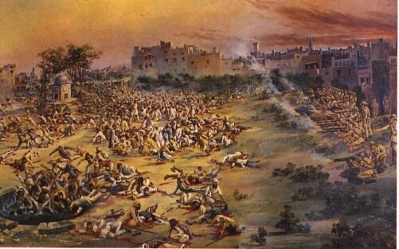
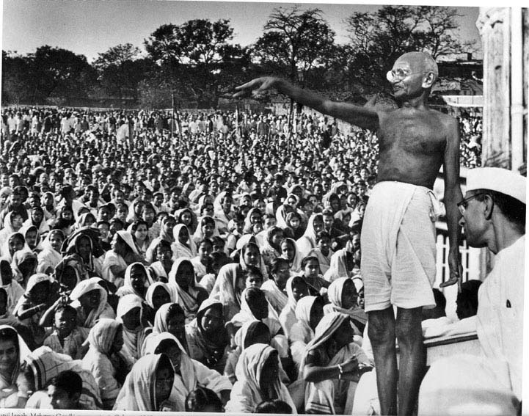
INDIAN PROTESTS BEGIN
1919 Amritsar massacre:
Peaceful protestors shot by British soldiers
A turning point:
Convinced many Indians of the need for complete independence
1920s:
Mohandas Gandhi emerged as a new leader:
United all Indians behind the drive for independence

Slide 5
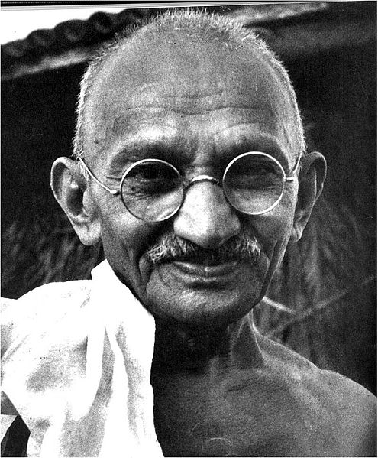
MOHANDAS GANDHI (1869-1948)
For his role in achieving Indian independence, Gandhi:
Has been compared to George Washington
Inspired people the world over
Influenced MLK jr. With his use of non-violent civil disobedience
Gandhi’s campaign of nonviolence slowly forced Britain to agree to hand over some power to Indians

Slide 6
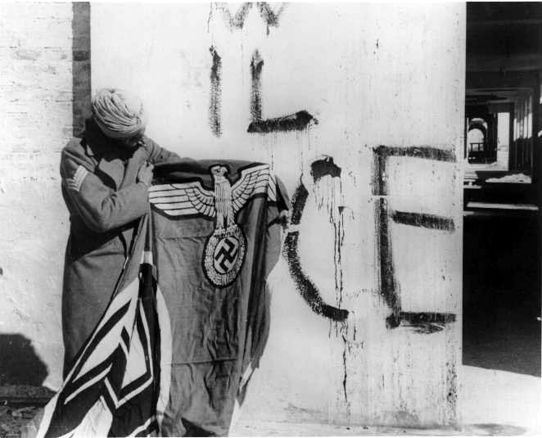

THE END OF BRITISH RULE IN INDIA
Britain outraged Indian leaders by:
Postponing further action on independence
Bringing India into WWII without consulting them
WW II:
Millions of Indians served in the British war effort
Angry nationalists launched a campaign of noncooperation
When WWII ended, independence could no longer be delayed

Slide 7
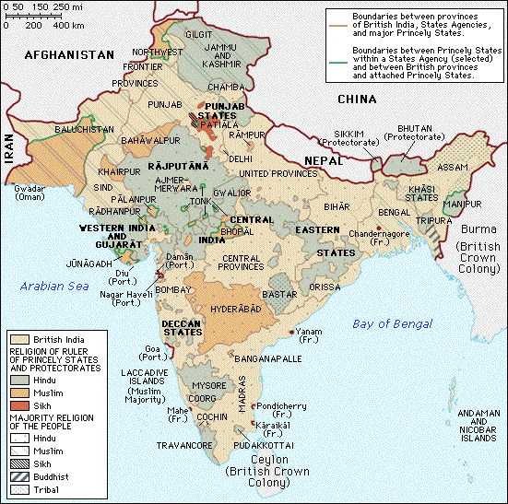
INDEPENDENCE & PARTITION
AS INDEPENDENCE NEARED, TENSIONS BETWEEN INDIA’S 2 LARGEST RELIGIOUS GROUPS BEGAN TO HEAT UP:
HINDUS
MUSLIMS
INDIA’S MUSLIM MINORITIES WANTED A STATE OF THEIR OWN

Slide 8
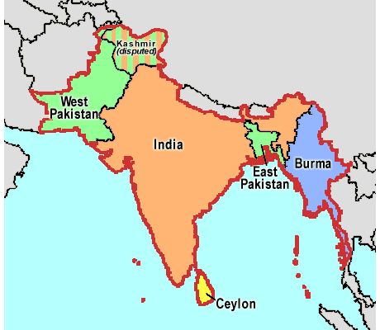
INDEPENDENCE & PARTITION (CONT’D)
IN 1947, BRITAIN PARTITIONED INDIA:
CREATED A HINDU INDIA
CREATED A MUSLIM PAKISTAN
PAKISTAN CONSISTED OF 2 SEPARATED SECTIONS:
WEST PAKISTAN
EAST PAKISTAN

Slide 9
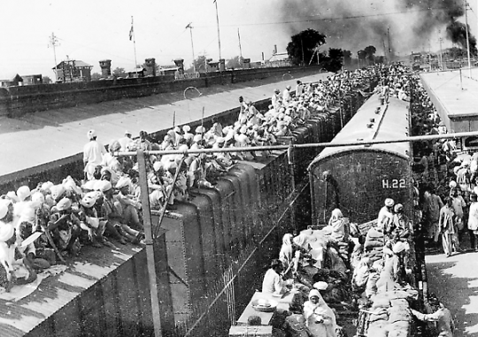
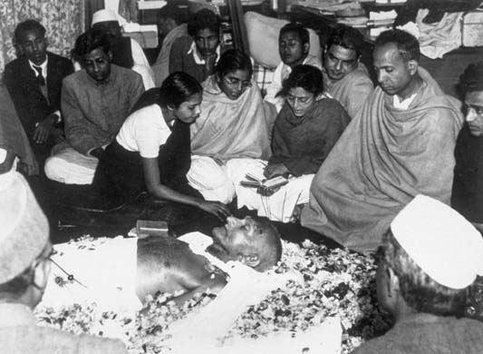
TRAGEDY UNFOLDS
The partition of India:
Uprooted millions of people who sought safety on the other side of the new borders
Unleashed violence between Hindus & Muslims:
Stemming from years of mistrust exploited by the British
Horrified, Gandhi, who had withdrawn from active politics, intervened & was killed by a Hindu extremist in 1948

Slide 10
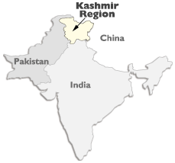
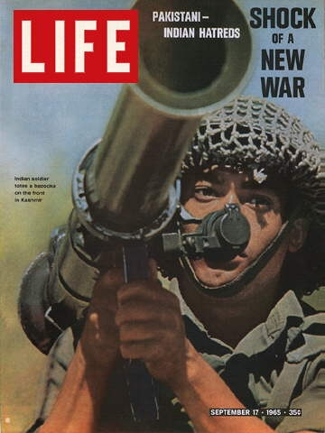
WARS BETWEEN INDIA & PAKISTAN
Fear & mistrust have defined relations between India & Pakistan.
At independence, border conflicts ignited a war over Kashmir, a state in the Himalayas.
Its Hindu prince signed Kashmir over to India, but its majority Muslim population wanted to be a part of Pakistan.
Since then, the 2 nations have fought several wars over Kashmir.

Slide 11
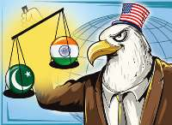

SOUTH ASIA & THE COLD WAR
During the cold war, India & Pakistan took different paths:
India welcomed economic aid from both superpowers but otherwise embraced neutrality (non-alignment)
Pakistan, feeling threatened both by India & the USSR to the north, accepted U.S. Military aid

Slide 12
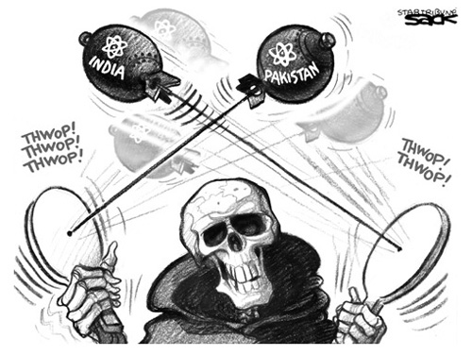

TENSIONS FUEL A NUCLEAR ARMS RACE
The danger from conflict rose after India became a nuclear power in 1974
Pakistan, feeling threatened, developed its own nuclear capabilities in 1998
Both nations refused to sign the non-proliferation treaty (1995)

Slide 13
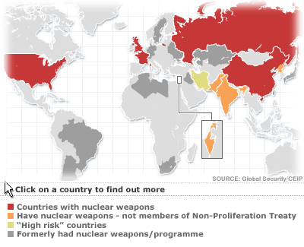
NUCLEAR PROLIFERATION IN THE POST COLD WAR ERA
In 1968, a number of nations signed the nuclear non-proliferation treaty (npt), agreeing to halt the spread of nuclear weapons.
During the 1995 treaty renewal debate, some nations refused to sign, questioning why some could have them (U.S., Russia) & others could not (India, Pakistan, Iran & n. Korea).

